Slide 1

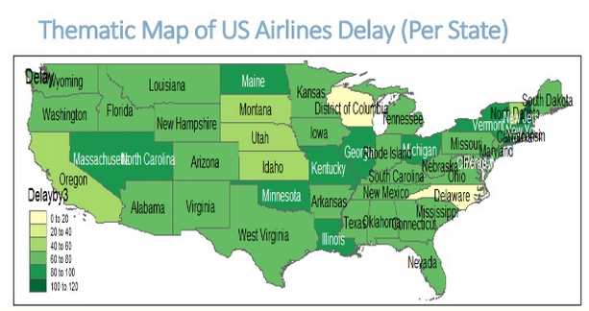
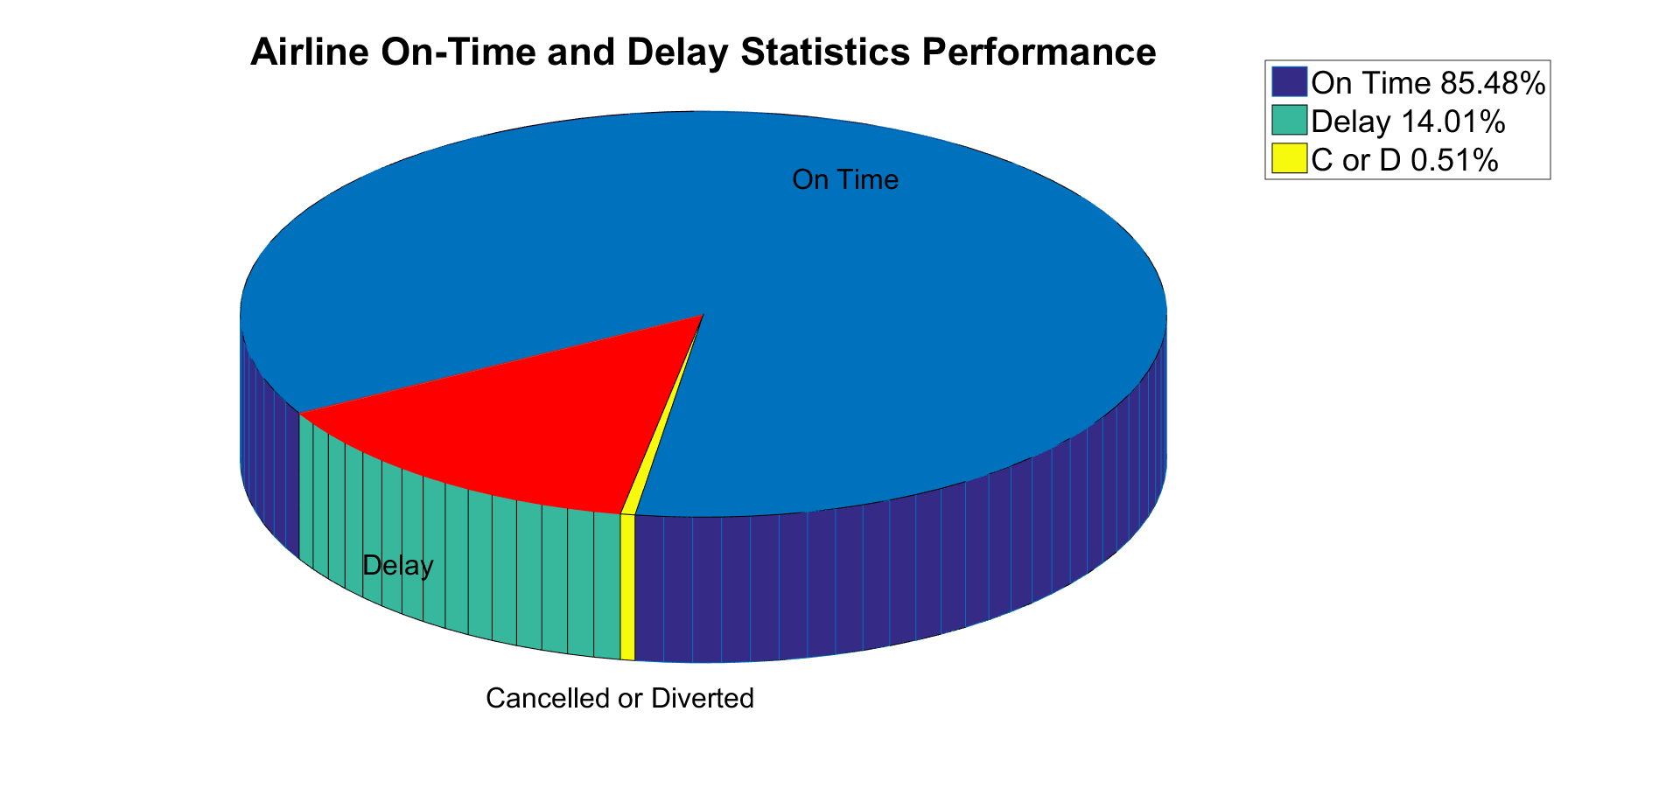
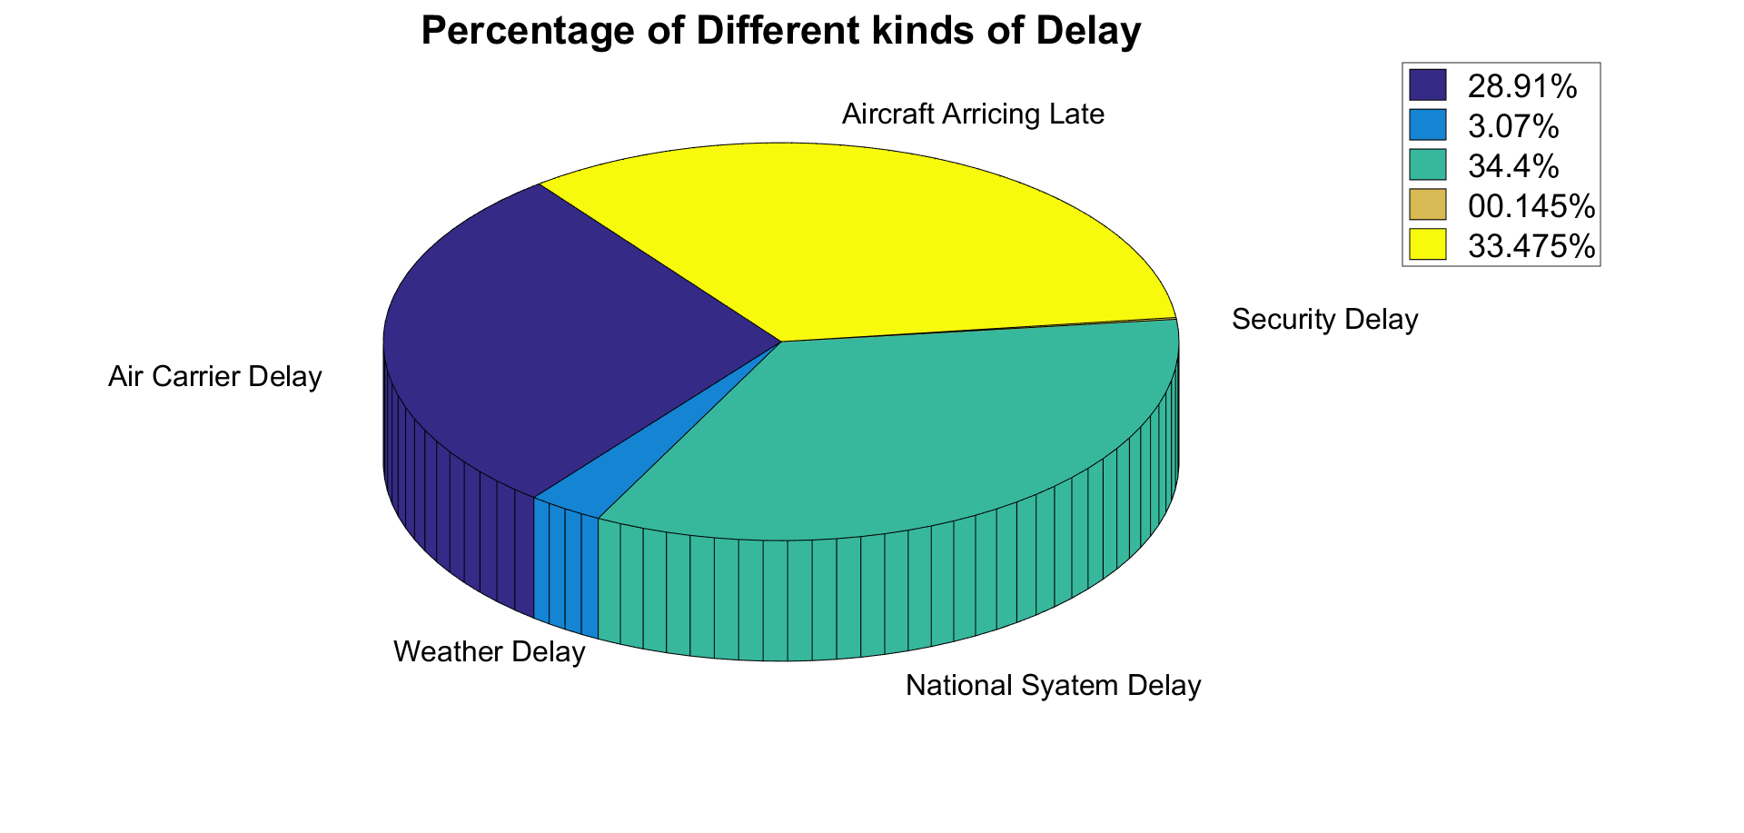
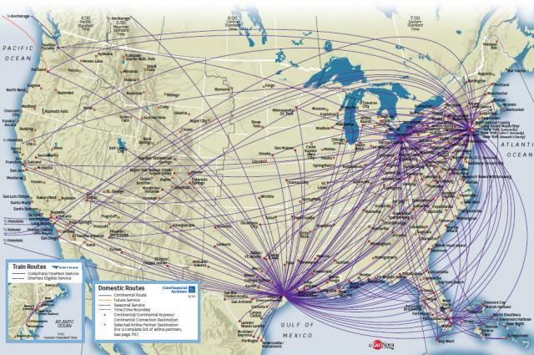
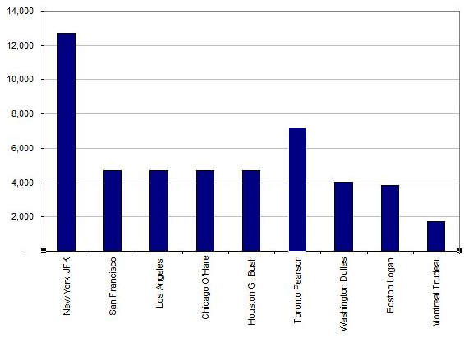
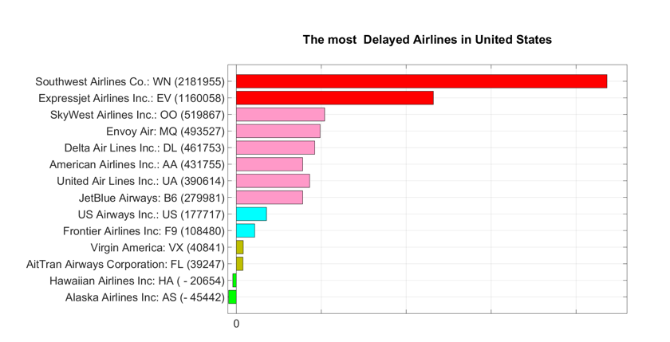
Analyzing Flight Data using Hadoop
Yeshwant Sai Sandeep Guntupalli, Aruna Veeramreddy, Musafer Hassan
Department of Computer Science
Instructor: DR. Jeongkyu Lee
University of Bridgeport, Bridgeport, CT
Abstract
In this period of the venture, we utilize Spark to examine flight dataset in view of the aggregate number of postponed per aircraft. We require additionally to get data about what is the most reasons for postponed, and what is the best air terminal.
In the contemporary world, Data investigation is a test in the period of changed buries teaches however there is a specialization in the separate orders. In any case, it is the enormous information which helps and quickens the procedure of examination of information clearing path for an achievement of any business insight framework. In this venture we are utilizing a flight information set, which comprises of 29 segments. By breaking down this information set with huge information apparatuses, for example, Hive, MapReduce, Spark. By utilizing Hive we can settle the huge information set by utilizing only a Sql question. Where as in MapReduce we get the outcomes by utilizing the Key, Value capacities. Where as in the Spark, we utilize the python programming to explain the inquiries. The last conclusion for this venture is that by utilizing the Big information apparatuses we understand the intricate inquiries productively. By utilizing the enormous information apparatuses we can likewise illuminate huge information sets.
Results and Evaluation
The results we get are astonishing. We know the most Delayed Airlines in United States as shown in the graph below.
Introduction
For analyzing the flight data we need to evaluate large abundance of data. We cannot solve this big data set using the regular tools easily. The general population dataset utilized as a part of this illustration comprises of flight landing and takeoff data for every business flight inside the USA for the year 2008, acquired from the Research and Innovative Technology Administration (RITA) which organizes the U.S. Division of Transportation research programs. The information was gotten from 30 business carriers and 3,500 airplane terminals, and comprises of nearly 7 million records. The US aircraft industry produces about $160 billion in yearly income, so it's no big surprise that both explorers and carriers cause incredible costs when almost 25% of flights are postponed or crossed out.
Main Body
Conclusion
The challenges incorporate not just the self-evident issues of scale, be that as it may moreover heterogeneity, need of structure, mistake-handling, security, opportuneness, provenance, what's more, perception, at all stages of the investigation pipeline from information obtaining to result elucidation. These specialized challenges are regular over a extensive assortment of application spaces, what's more, in this manner not taken a toll ­‐effective to address in the setting of one space alone. By analyzing these data sets we can easily get the required outputs easily. We can solve very large data sets that the contemporary tools find difficult to solve.
While analyzing the dataset we came across five different scenarios for our analysis. Out of these , we implemented one by using MapReduce programming, two scenarios with Hive and rest with the Spark. In hive we solve the large data sets using the simple SQL query. In the background hive works same as the MapReduce.
For the MapReduce, It usually splits the input data-set into independent chunks which are processed by the map tasks in a completely parallel manner. The framework sorts the outputs of the maps, which are then input to the reduce tasks. Typically, both the input and the output of the job are stored in a file-system. The framework takes care of scheduling tasks, monitoring them and re-executes the failed tasks.
CPSC 651 – Big Data and Data Analytics

